Slide 1

AREEFA
https://www.linkedin.com/in/areefa-4530a6192/

Slide 2

Day 1
Theory + Practical Session

Slide 3
3 Building Steps in creating a ML model
Dataset Collection
Training Model
Test Model

Slide 4
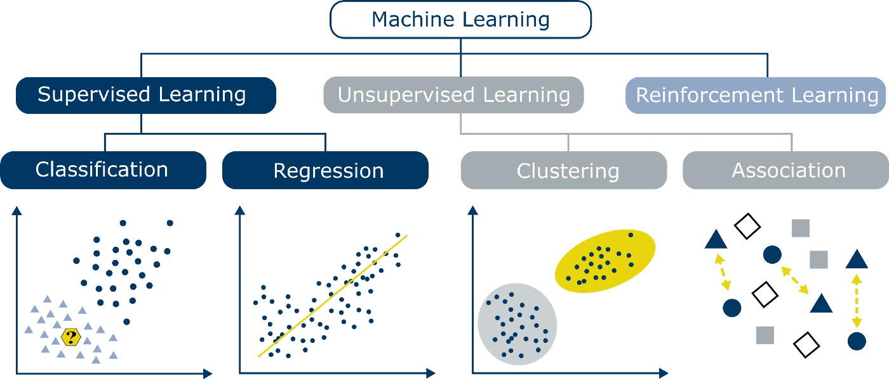
Algorithms Classification

Slide 5

Case Study – Client Company
Company is actively recruiting people with different work experiences. It is becoming problematic for the HR team to personally review the documents of work experience to finalize CTC/salaries on their offer letters manually.
Consequences:
Delayed release of offer letters.
Delayed Joining Dates release
Overdue work for HR Team.

Slide 6
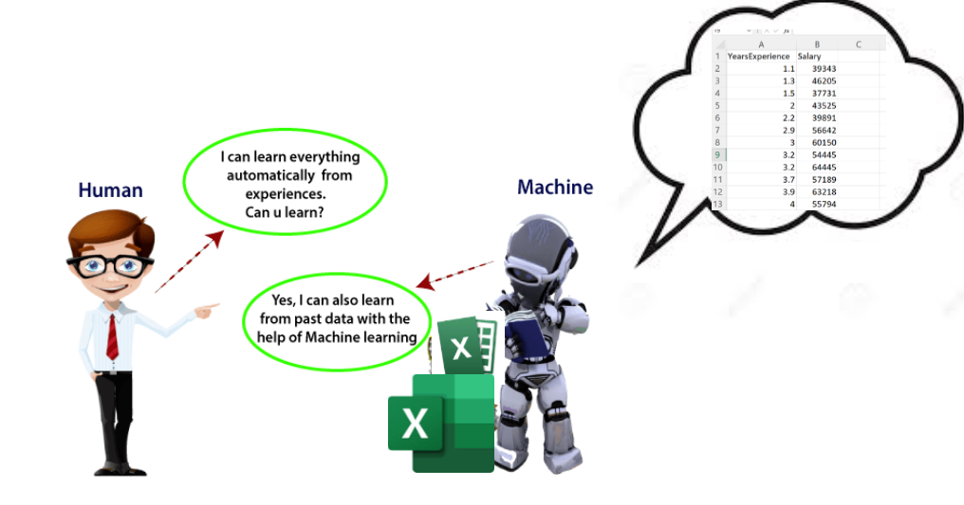
Working On Case Study
What if we could involve a machine here that could predict salaries and automate the whole thing?
Company had provided the previous Employee salaries data.

Slide 7

Let's Work!
Open Jupyter Notebooks
Trigger draft mail - datasets

Slide 8
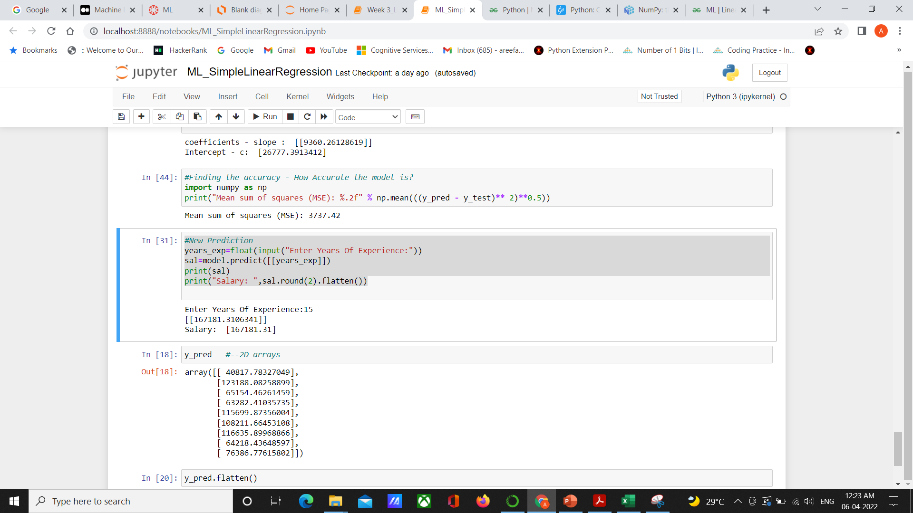

Slide 9


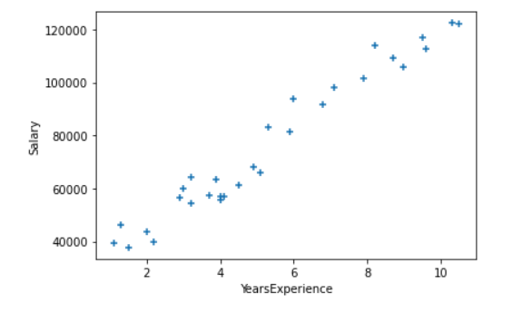
STEPS TO TRAIN ML MODEL
Load the Dataset
1
Visualize and preprocess
2
Split dataset into training set and test set
3
Fit Simple Linear Regression model to training set
4
Predict the test set
5
Visualizing the Results
6
Make new predictions
7

Slide 10

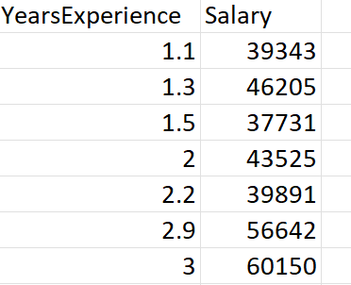
Why Linear Regression?
Linear Regression is a machine learning algorithm based on supervised learning.
It performs a regression task. Regression models a target prediction value based on independent variables. It is mostly used for finding out the relationship between variables and forecasting.
Regression Problem
Need to predict the real values

Slide 11

DAY 2

Slide 12

Algorithm Fitting

Slide 13
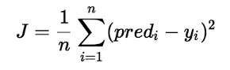
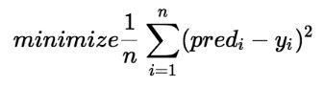
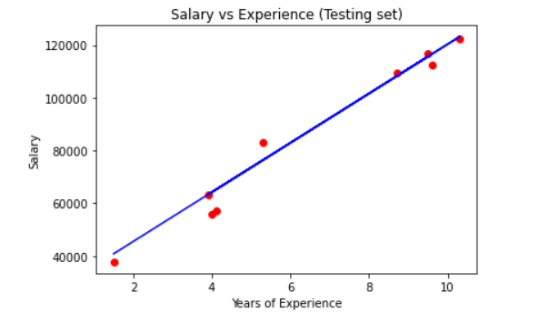
What’s Actually happening?
Finding the Best Fit Line – With Minimized error / Cost Function – Gradient Descent Mechanism
Error
Aim
Where predi is Y(pred) = mx + c

Slide 14

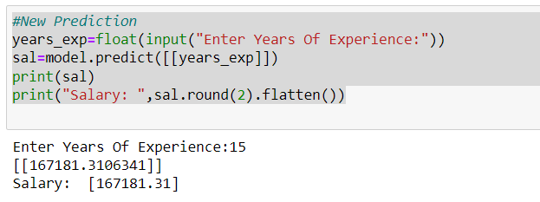
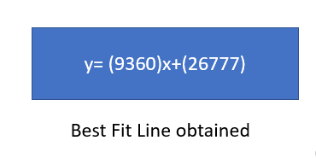
Final ML Model: We deliver to Client

Slide 15



Slide 16


Case Study: Client - Government
Incidence of Malaria is significantly higher in Summer when compare to winter. The growth cycle increases with higher temperatures and humidity climates.
So, the health department is funding for the solutions given by the young techies to warn the people about Malaria outbreak detection in their areas.
“Reaching the Zero Malaria target.’’ – 2022
TURNED INTO HIGH BUDGET PROJECT

Slide 17
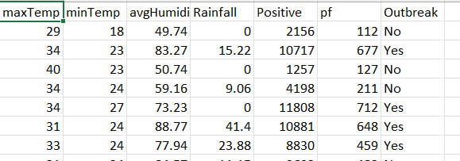
Driving the Solution
As the Outbreak of malaria depending upon the weather conditions, let’s consider this dataset.
Prediction
Features

Slide 18
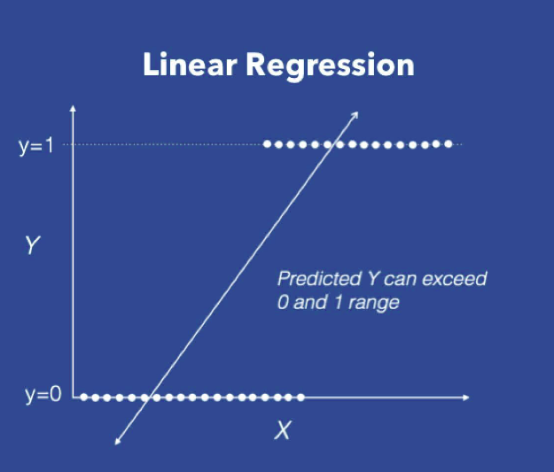
Will the Linear Regression approach also work for Classification ?
Given the weather conditions, we need to predict whether outbreak of malaria is severe or no. ( y=0 for not severe and y=1 for severe ).
In the regression setting, we could fit a line of best fit and predict that the points above a particular threshold on the line are (severe outbreak) and the points below that points are (not severe).
There are some problems with this approach:
The Value of Y can exceed 1 and go below 0. But, we want an output as a probability of occurrence of the expected output. with this probability, we should be able to classify the output.
Leverage points may affect this line drastically.

Slide 19
Logistic Regression
It is a classification – not a Regression algorithm.
Classification: It is a type of problem where the data scientist has to find the relationship between the independent variables and the Discrete Dependent variable and use that to give accurate future predictions.
It is used to estimate discrete values (Binary values like 0/1, true/false, yes/no) based on given set of independent variable(s).

Slide 20
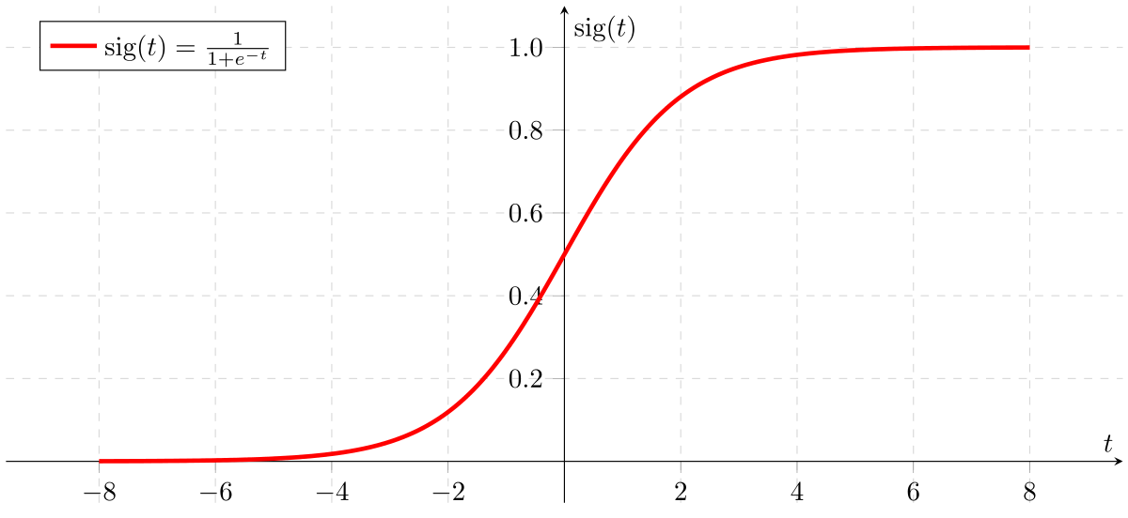
Keywords
Probability of occurrence of malaria and Probability of not occurrence of malaria
Why there is Regression in the name of the Algorithm – Logistic Regression though it is not applicable for Regression Problem?
Sigmoid Function
Cost Function
Gradient Descent
If x=∞, sig(x)=1, if x=- ∞ sig(x)=0, if x=0, sig(x)=0.5
Logistic Regression predicts the probability of occurrence.
Logistic Regression is one of the Generalized Linear Model.
Hence, we use Sigmoid Function.
The sigmoid function is the magic function that let’s us get the desired probability as an output. It does this by squishing any value to fit between 0 and 1.
z = x*w + b where w is the weight and b is the bias.
h_theta = sigmoid(z)

Slide 21
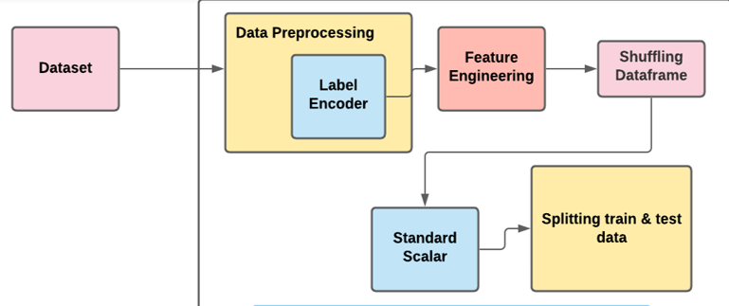
Let's Work!
Open Jupyter Notebooks

Slide 22
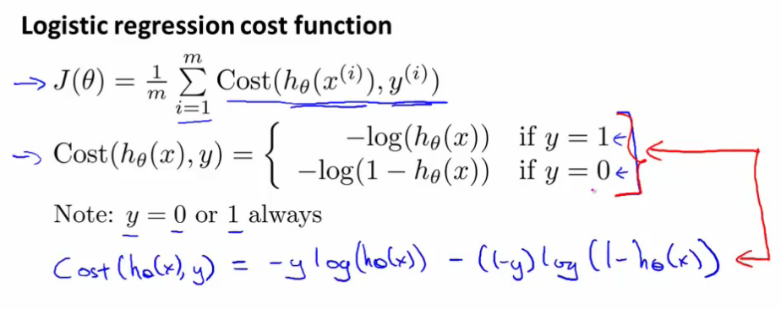
Cost Function in Logistic Regression
As gradient descent is the algorithm that is being used, the first step is to define a Cost function or Loss function. This function should be defined in such a way that it should be able to tell us how much the predictions of our model deviates from the original outcome.

Slide 23
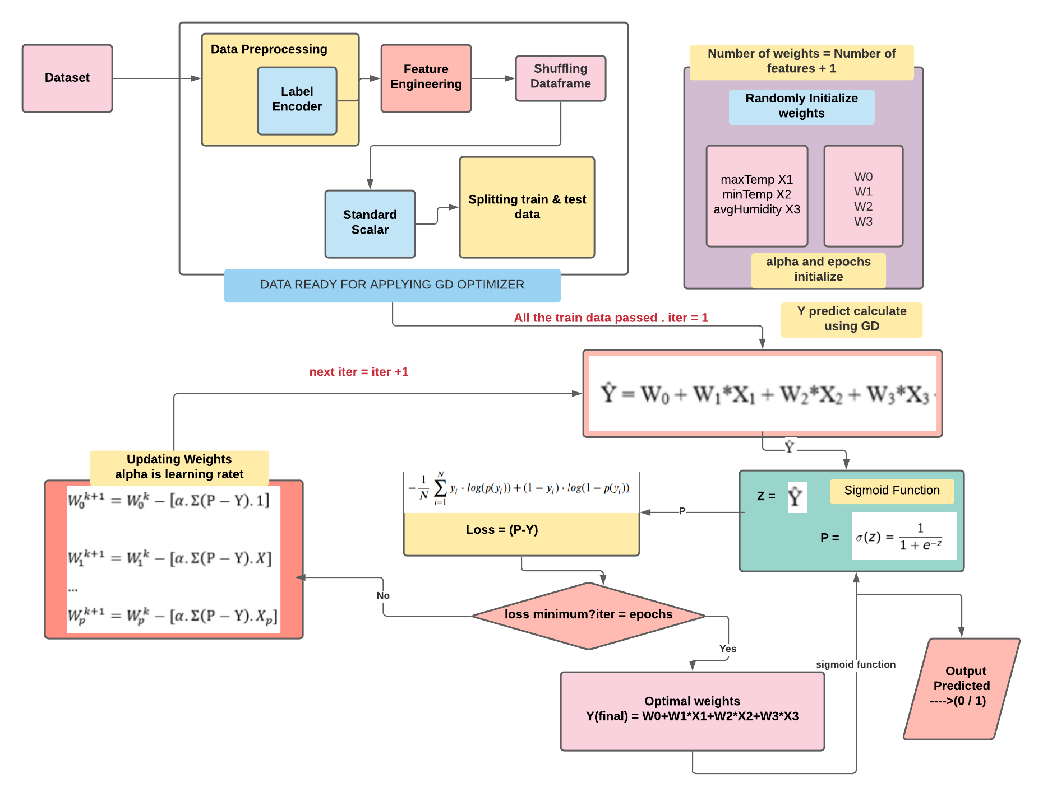
Using Gradient Descent Optimizer
To predict the Outbreak of malaria based on the weather condition, we had applied Logistic Regression without using the scikit-learn library. Instead, we had applied the GD (Gradient Descent) Optimizer and predicted the outbreak probability.

Slide 24
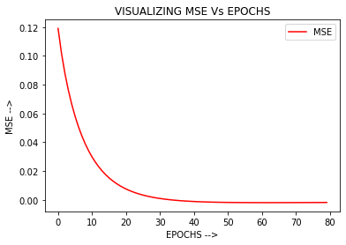
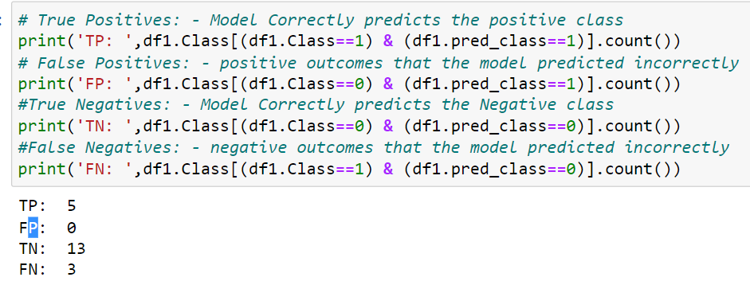
Evaluating Model

Slide 25


So are we going to Deliver our Model to the Government?..............Not Yet………

Slide 26
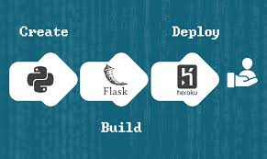
A ML model has no existence or no life until it is deployed.
We need to either deploy it over a Web Application or an Android Application.
Lets look into this in a mean time.

Slide 27
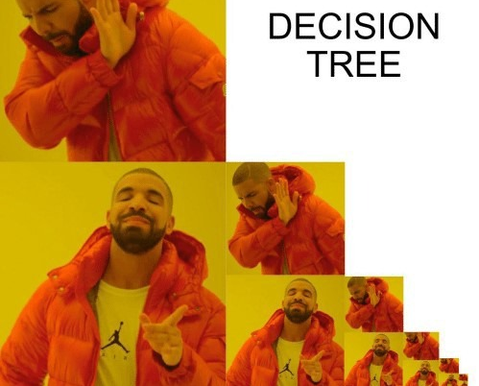
DECISION TREE
Can’t understand this meme?
Then listen to this topic.

Slide 28
definition
Decision Tree Algorithm falls under the category of Supervised Learning. They can be used to solve both regression and classification problems.
Its similar to the Tree Data Structure which has a root, multiple other types of nodes.
It is to split dataset as a tree based on set of rules and conditions.

Slide 29
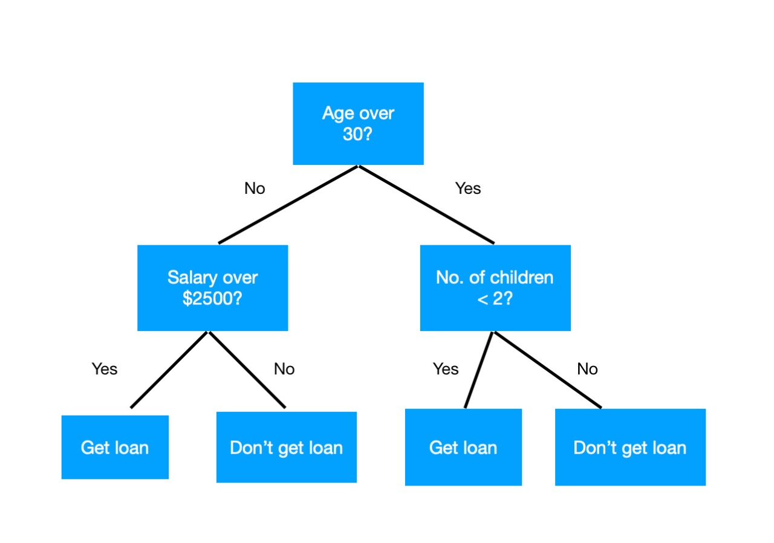
A simple decision tree
Approve loan on the basis of the age, salary, no. of children and reach a decision at leaf node to get loan or not.

Slide 30
Meme Interpretation
No
No
Yes
no
Yes
yes

Slide 31
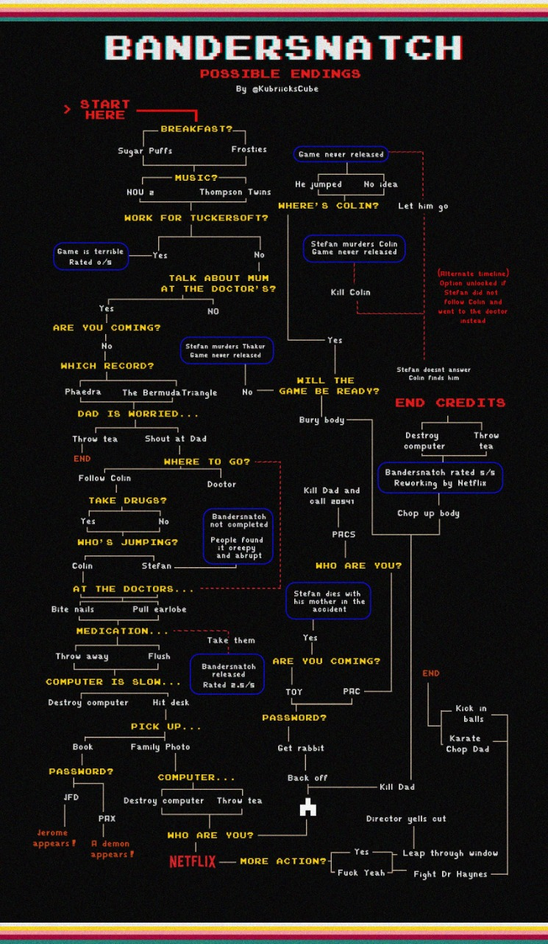

REAL TIME APPLICATION

Slide 32
Creation & Types
In the beginning whole data is considered as the root, we use algorithm to make a split or divide the root into subtrees.
Categorical variable decision tree: It has categorical target variable.(predict relative price of computers as low,med,high and decides finally)
Continuous variable decision tree: Features input to the decision tree.(qualities of a house will be used to predict a continuous output that is price of that house)

Slide 33
Advantages &Disadvantage
It takes less time in processing the data.
Few preprocessing steps can be skipped.
Easy to explain and can be implemented across several organisations.
Time required to make predictions.
Unstable
Prone to overfitting.

Slide 34

Flask App Practical Explanation

Slide 35

Now its deliverable..!
We Did It!!!!

Slide 36

MODEL 1: Dataset – Malaria Detection(Laboratory level)
NIH has a malaria dataset of 27,558 cell images with an equal number of parasitized and uninfected cells.
A level-set based algorithm was applied to detect and segment the red blood cells. The images were collected and annotated by medical professionals.

Slide 37
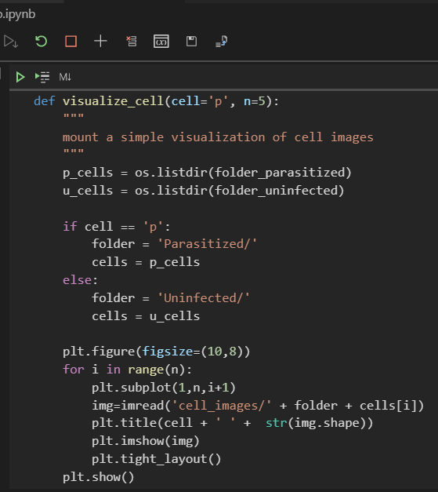
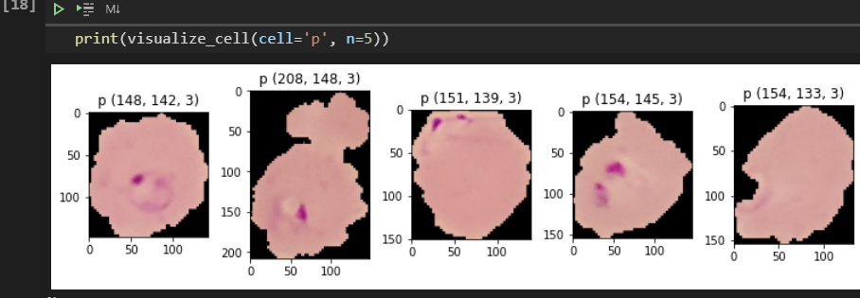
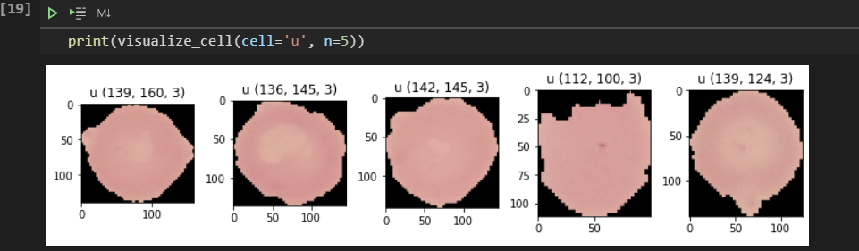
VISUALIZING DATASET

Slide 38

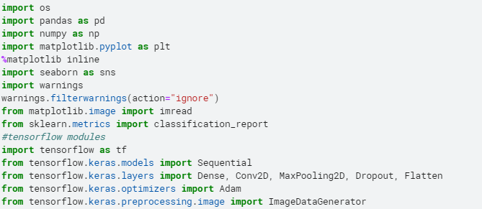
Framework and Libraries
Keras is just an interface that allows you to easily access and customize the backend machine learning frameworks like TensorFLow.
Directly using these frameworks are complex. Thus, many prefer a high-level API such as Keras to run on top of them mainly in Neural networks.

Slide 39
STEPS FOLLOWED
Why CNN?
Deep learning, there are several types of models such as the ANN, RNN, reinforcement. But there has been one particular model that has contributed a lot in the field of computer vision and image analysis which is the Convolutional Neural Networks (CNN)
Read
Read the dataset after downloading.
Pre-process
Pre-process the images (resize)
Develop
Develop CNN model
Compile
Compile CNN model (optimizer = ‘adam’ and specify metrics)
Train & validate
Train & validate the model
Test/ Predict
Test/ Predict the trained model
Compare
Compare accuracies (training & testing)
Deploy
Transform Trained model into Deployable model to build an application.

Slide 40
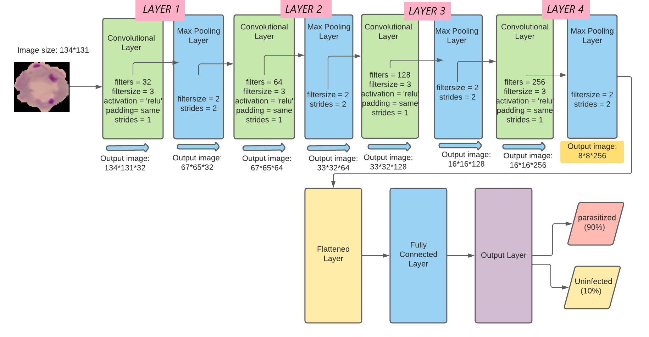
CUSTOM CNN ARCHITECTURE – MODEL 1
The proposed model by us is based built according to the main blocks of CNN as shown below:
Input Image
Convolutional Layers
Activation Function – ReLU
Max Pooling Layers
Flattening Layer
Fully Connected Layer
Output Layer

Slide 41
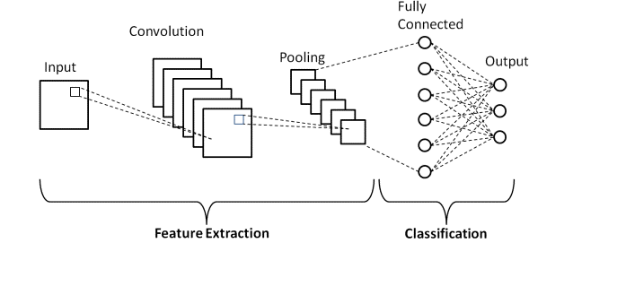
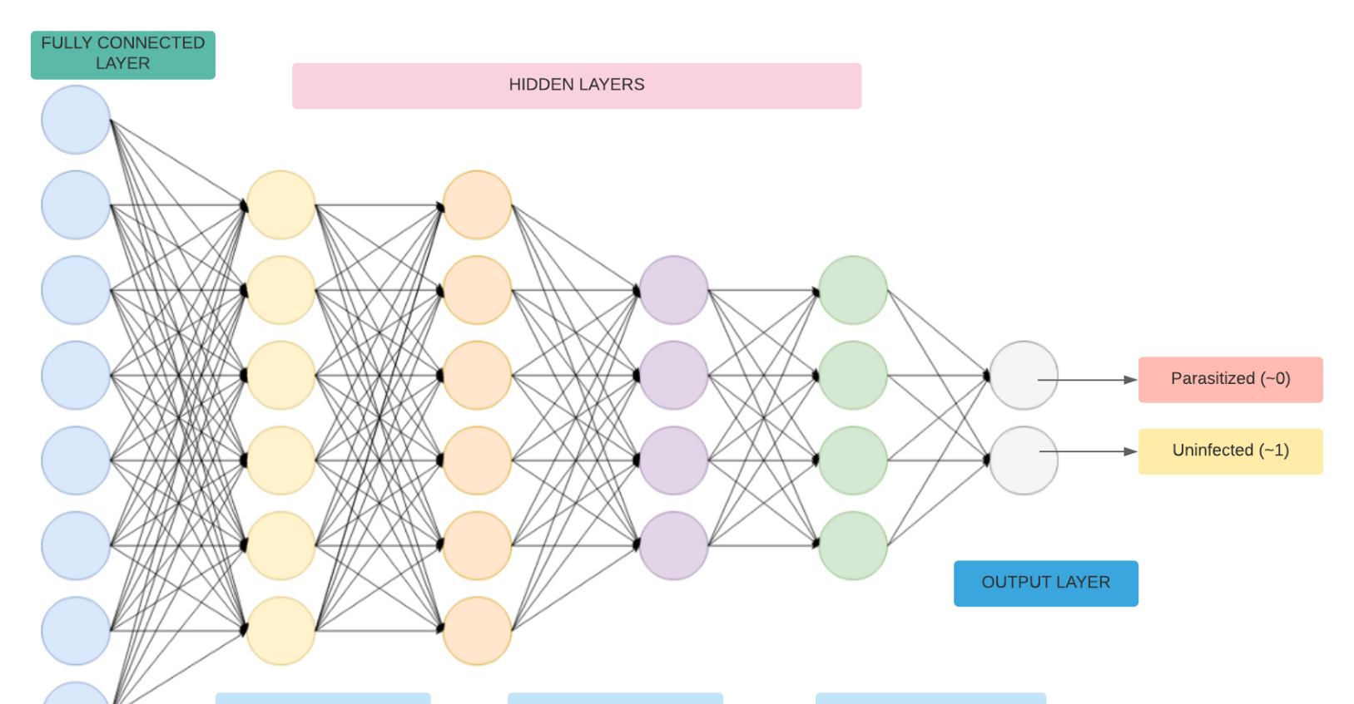
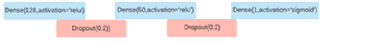
Layers responsible for Classification

Slide 42
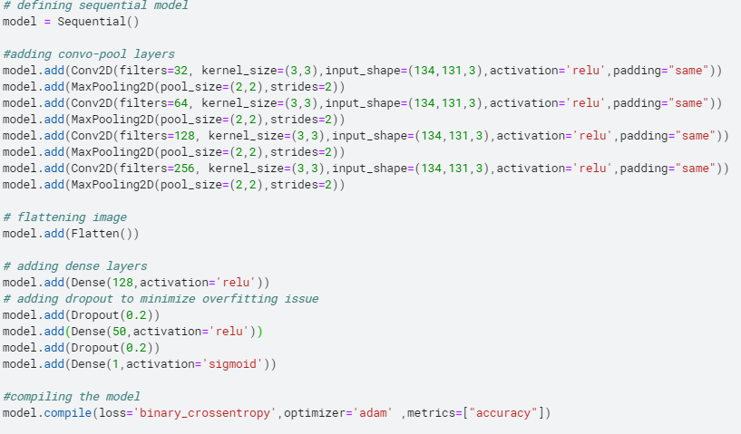
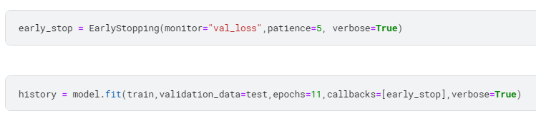

Slide 43
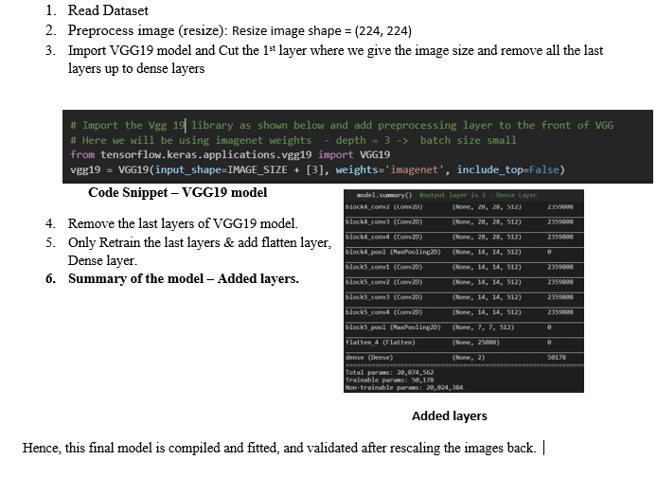
TRANSFER LEARNING MODEL – VGG19
Transfer learning models are already trained in the classification of 1000’s classes. We can directly use them by tuning the classes according to our needs.

Slide 44

My whole Project

Slide 45

THANK YOU
AREEFA
8466961585
areefahnk@gmail.com
https://www.linkedin.com/in/areefa-4530a6192/
https://github.com/Areefahnk

